Slide 1
Influencer Marketing 2.0

Slide 2
Overview
What Is Marketing
What Is An Influencer
How Does Influencer Marketing Work
The Laws of Influencer Marketing How To Become A Person of Influence
Next Steps

Slide 3
Marketing 101
“Marketing is the name we use to describe the promises a company makes, the story it tells, the authentic way it delivers on that promise.” Seth Godin
Your content is your marketing. If you want to be an influencer, consider your space, story, content and solutions you provide the brand.

Slide 4
Marketing 101
The Four P’s of Marketing (Philip Kotler)
Product Place Promotion
Price
The 5th P
Purpose My 6th P
PEOPLE

Slide 5
Why Marketing Matters
Marketing is about the stories we share, and the intended audience we share them with.
Marketing connects us to our people. Marketing builds trust and relationships that can turn into referrals which create revenue.

Slide 6
What Are Influencers?
Storytellers
Advocates
Content Creators
Cheerleaders
Connectors
Those that have “influence” over a specific audience a brand seeks to engage with.

Slide 7
Types of Influencers
Celebrity Influencer
Influencer (over 100K)
Micro Influencer (under 100K)*
*Some brands are now working with Micro Influencers with audiences of 5000 and it’s working

Slide 8
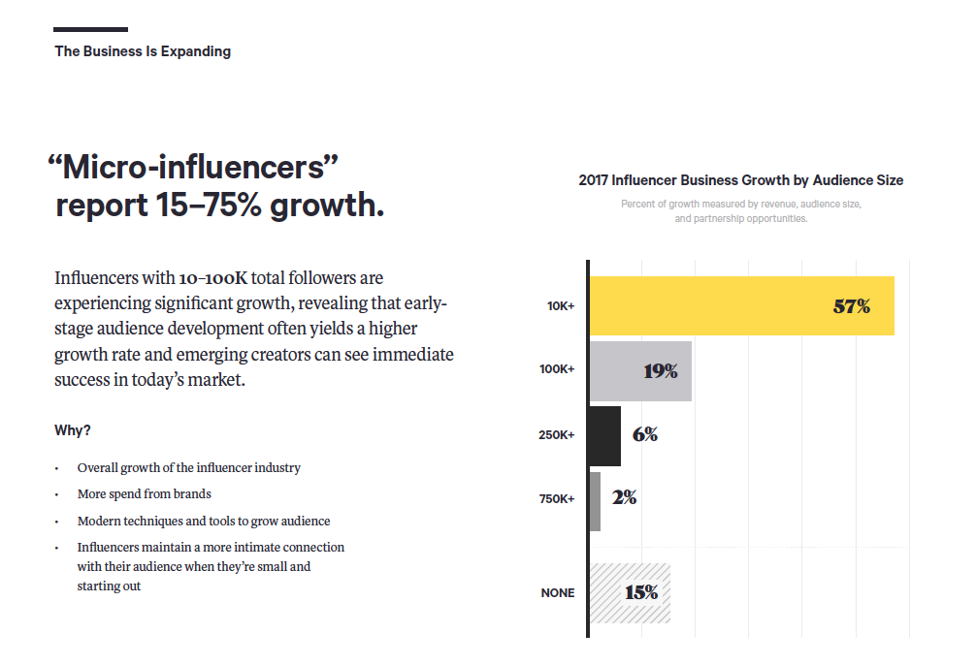
The Rise of The Micro Influencer

Slide 9
Why Do Influencers Matter?
Brands have been using some type of influence for years.
Think endorsement.
Celebrity.
Thought leaders.
But that was long before social media.

Slide 10
Why Do Influencers Matter?
People trust their “friends” advice and recommendations over brand advertising
Consumers trust other consumers more than they trust brands
With the rise of social, brands have an opportunity to engage influencers to tell their story to their tribes
Those stories connect new users to the brand

Slide 11
How Does Influencer Marketing Work?
Person creates content and tells stories
Through that content, person builds loyal following
Brand notices persons influence and followers
Brand engages with person on social
Person notices brand
Brand reaches out to person for deeper relationship

Slide 12
How Does Influencer Marketing Work?
Person creates content and tells stories
Through that content, person builds loyal following
Person reaches out to Influencer Agency seeking support
Agency connects person with brands and takes a %

Slide 13
How Does Influencer Marketing Work?
Brand has PR agency that does outreach
PR agency builds list of “influencers”
PR agency creates packages to send to influencer around product and program launches
Brand hopes people will share the package with their community (aka “unboxing”)

Slide 14
Different Influencer Relationships
Free product deliveries
Paid Posts
Content Creation (non exclusive)
Content Creation (exclusive)
Events + Appearances
Contract (Brand Ambassador)
Collabs

Slide 15
How Do Influencers Get Paid?
Product
Trips
Exclusive Invites
Money
“Exposure”

Slide 16
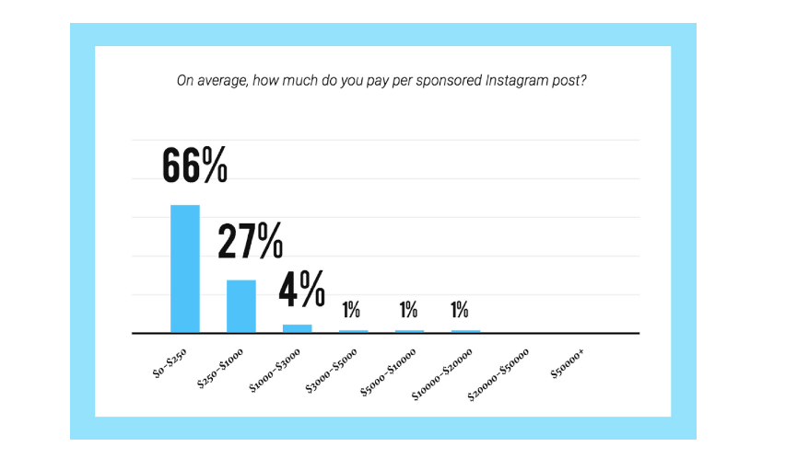
Let’s Talk Money

Slide 17
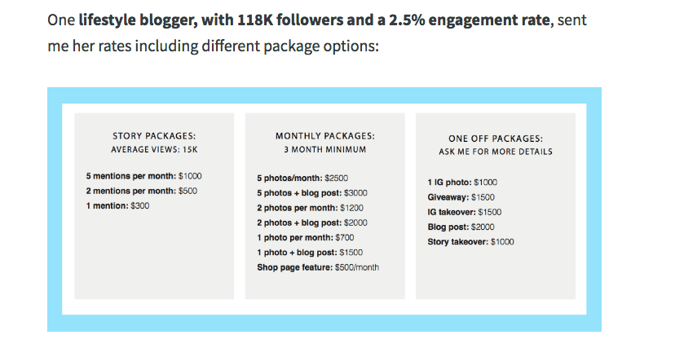
Let’s Talk Money

Slide 18
Let’s Talk Money via Buffer app

Slide 19
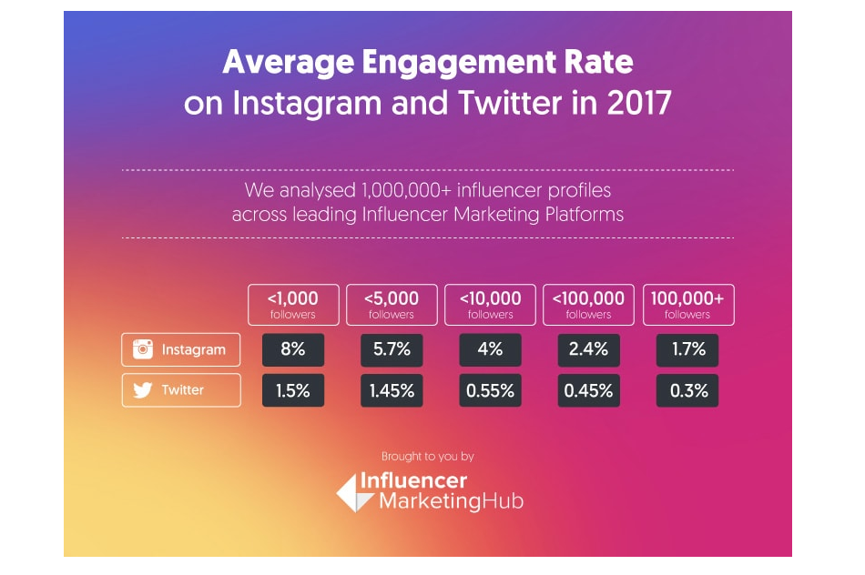
Let’s Talk Money via Influencer Marketing Hub

Slide 20
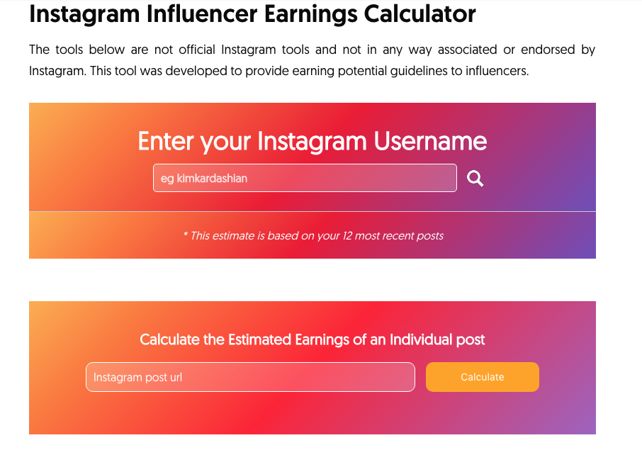
Let’s Talk Money via Influencer Marketing Hub

Slide 21
Why Do Influencers Matter?

Slide 22
Why Do Influencers Matter?

Slide 23
Why Do Influencers Matter?

Slide 24
Why Do Influencers Matter?

Slide 25
Why Do Influencers Matter?

Slide 26
Why Do Influencers Matter?

Slide 27
Why Do Influencers Matter?

Slide 28
Why Do Influencers Matter?

Slide 29
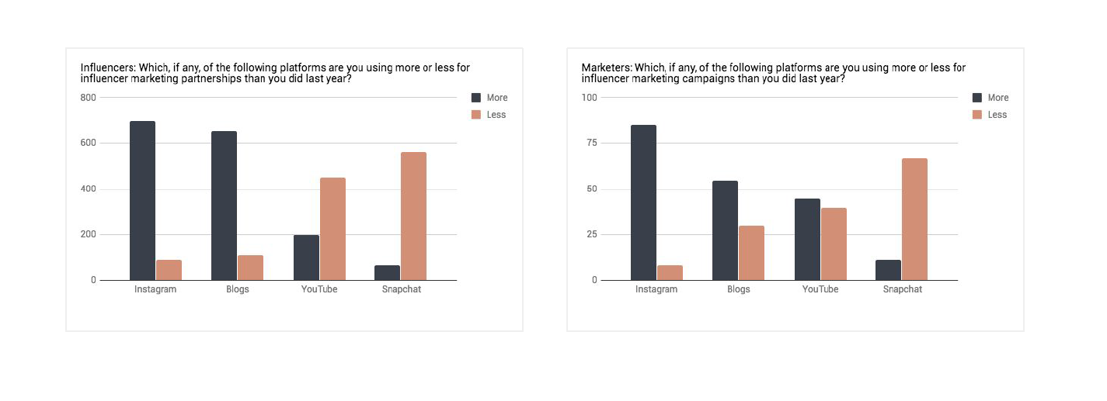
2018 Changes + Updates: ACTIVATE 2018 Study

Slide 30
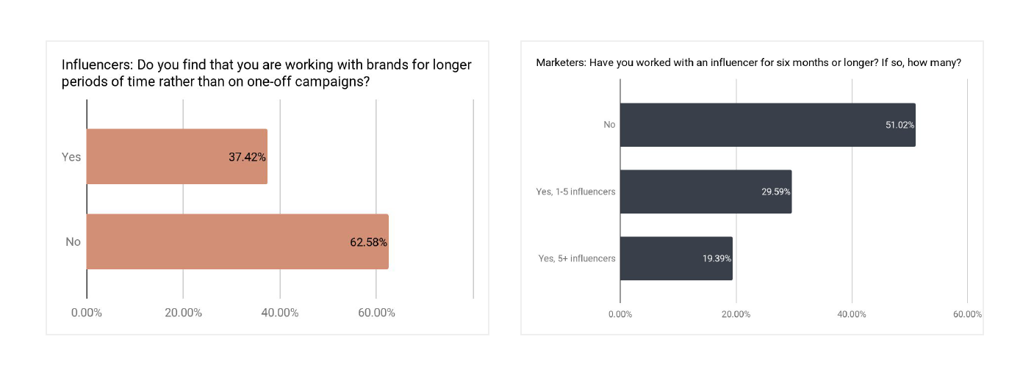
2018 Changes + Updates

Slide 31
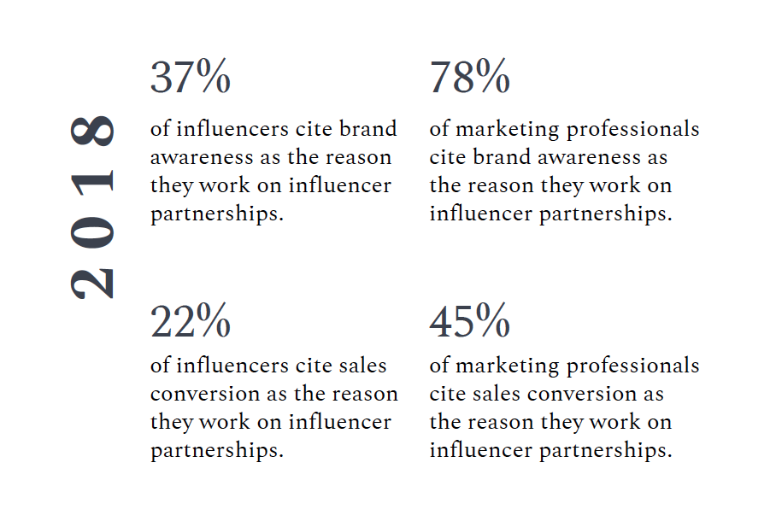
2018 Changes + Updates

Slide 32
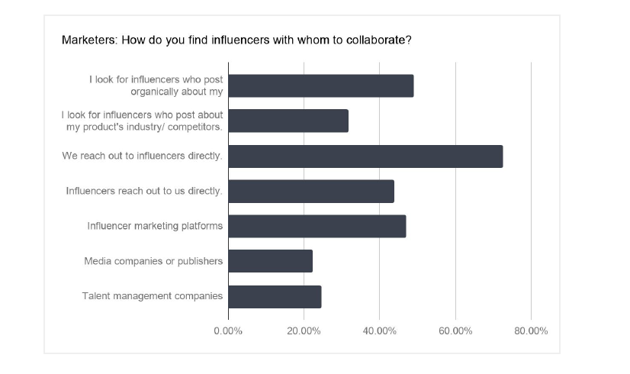
2018 Changes + Updates

Slide 33
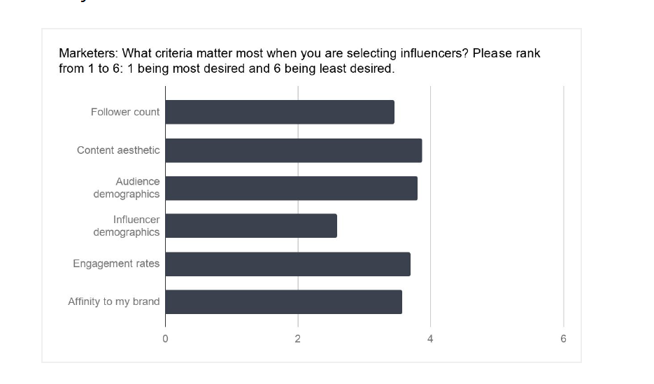
2018 Changes + Updates

Slide 34
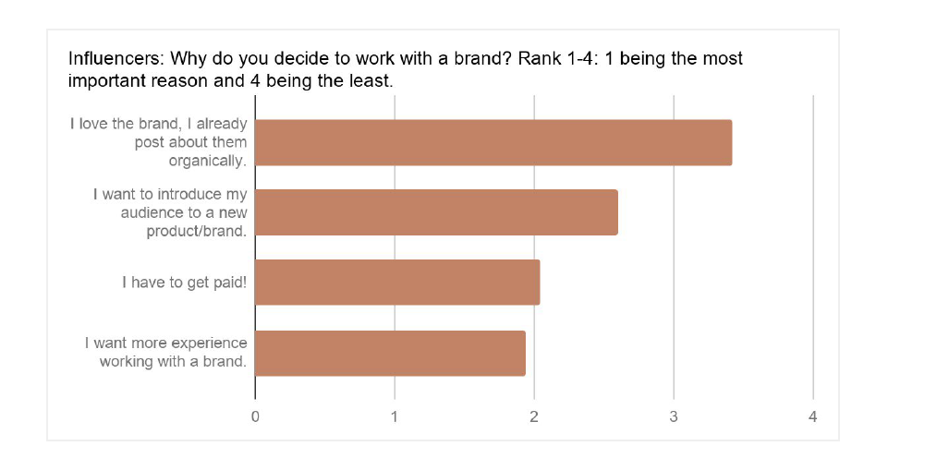
2018 Changes + Updates

Slide 35
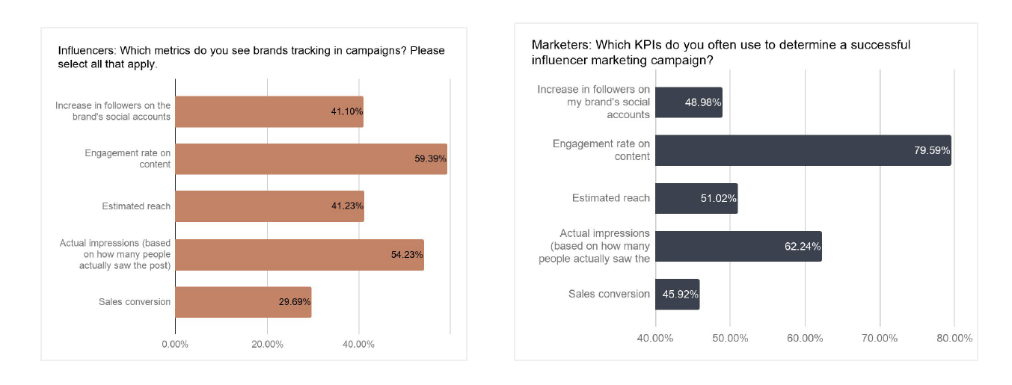
2018 Changes + Updates

Slide 36
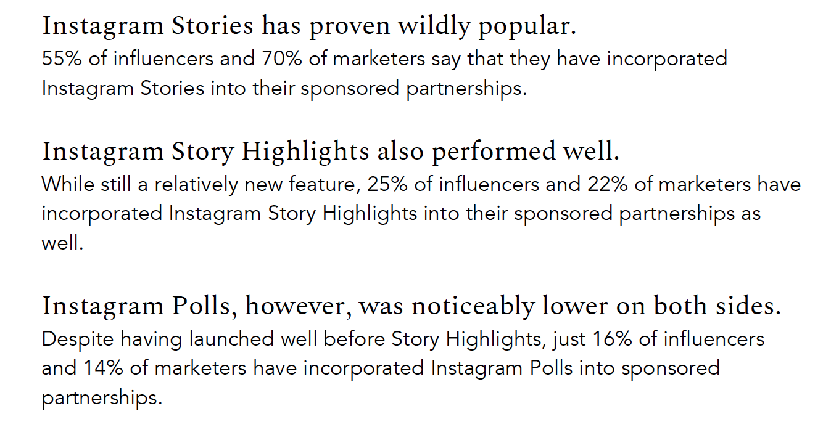
2018 Changes + Updates

Slide 37
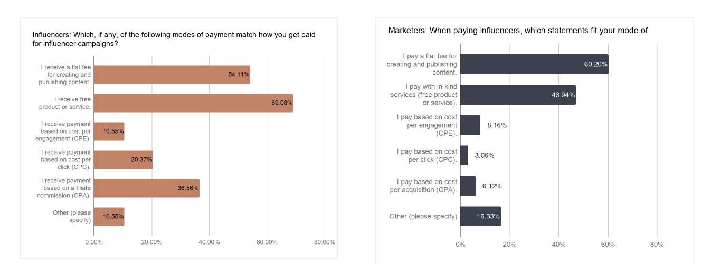
2018 Changes + Updates

Slide 38
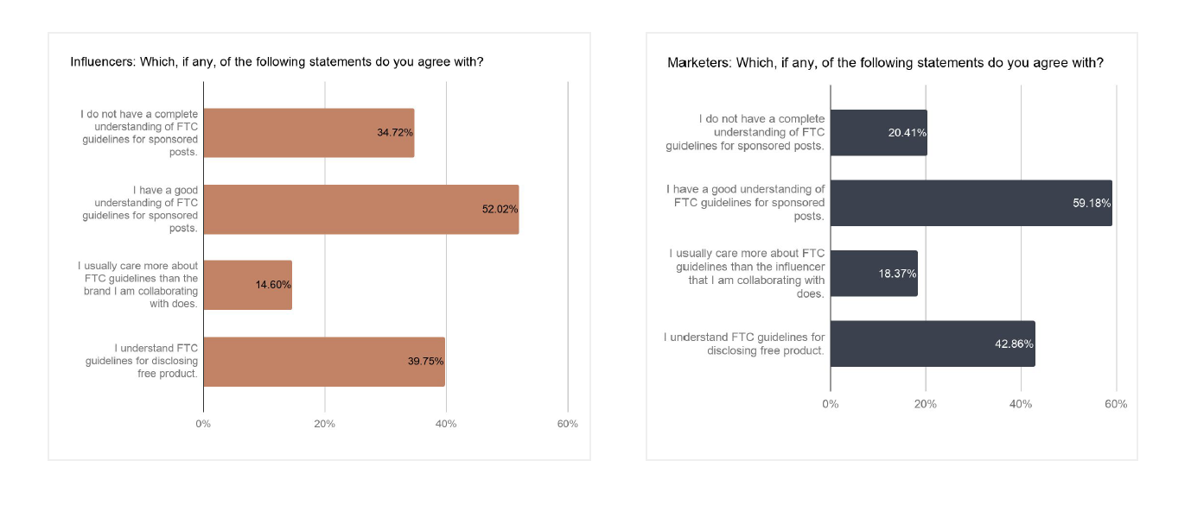
2018 Changes + Updates

Slide 39
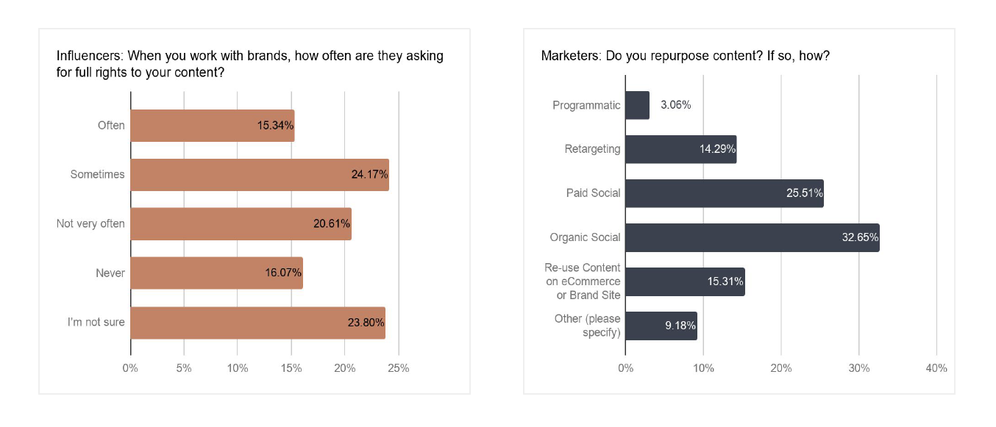
2018 Changes + Updates

Slide 40
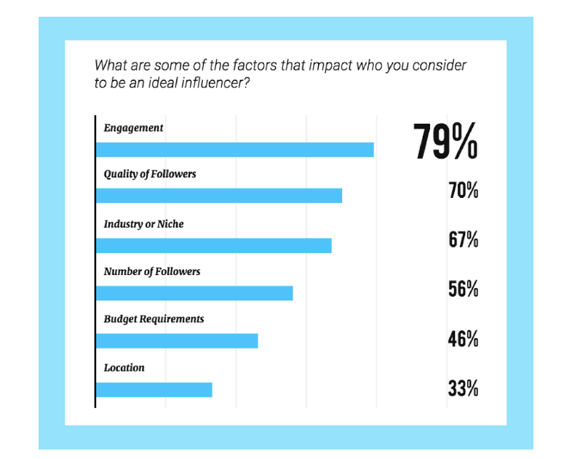
2018 Changes + Updates Later App Blog

Slide 41
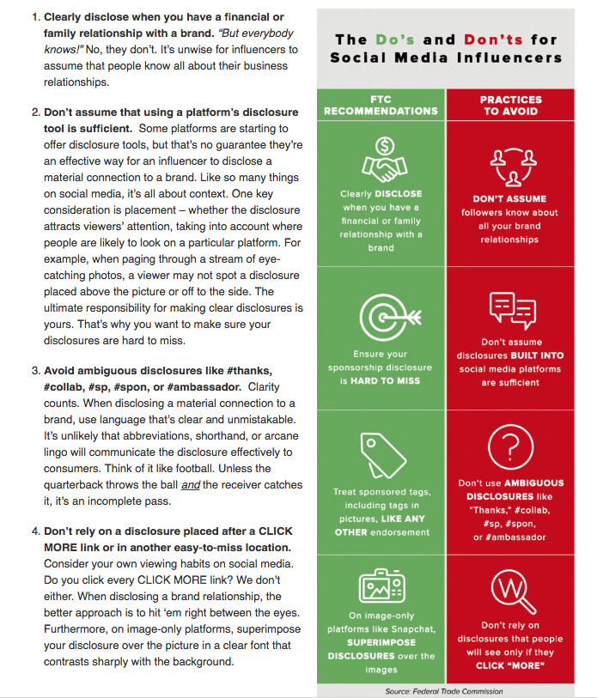
Let’s Talk Legal #ad
www.ftc.gov/tips-advice/business-center/guidance/ftcs-endorsement-guides-what-people-are-asking

Slide 42
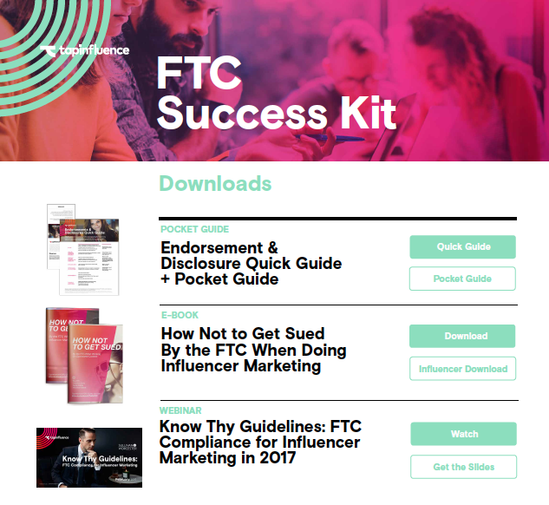
Let’s Talk Legal
www.tapinfluence.com/ftc/#Download
NOTE: This is not the most updated guidelines but is a good resource. Always refer back to the FTC guidelines for the most recent developments.

Slide 43
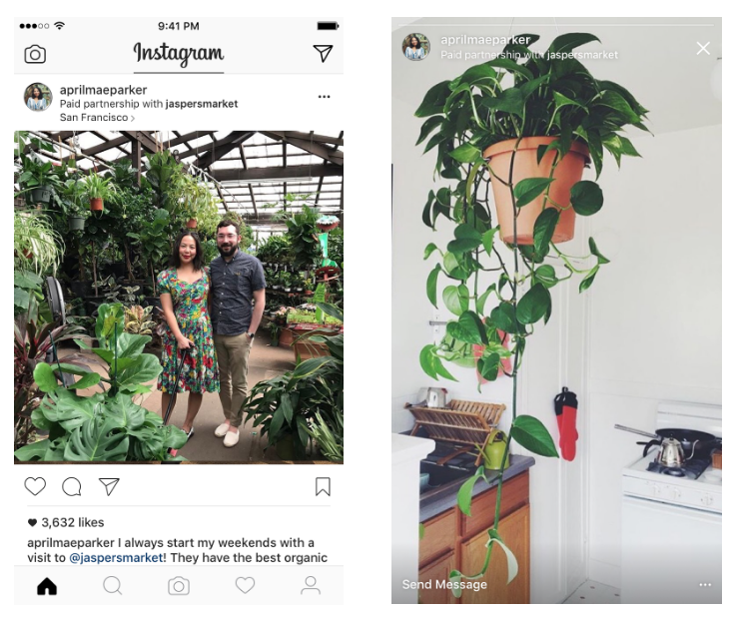
Let’s Talk Legal- Instagram
www.business.instagram.com/a/brandedcontentexpansion

Slide 44
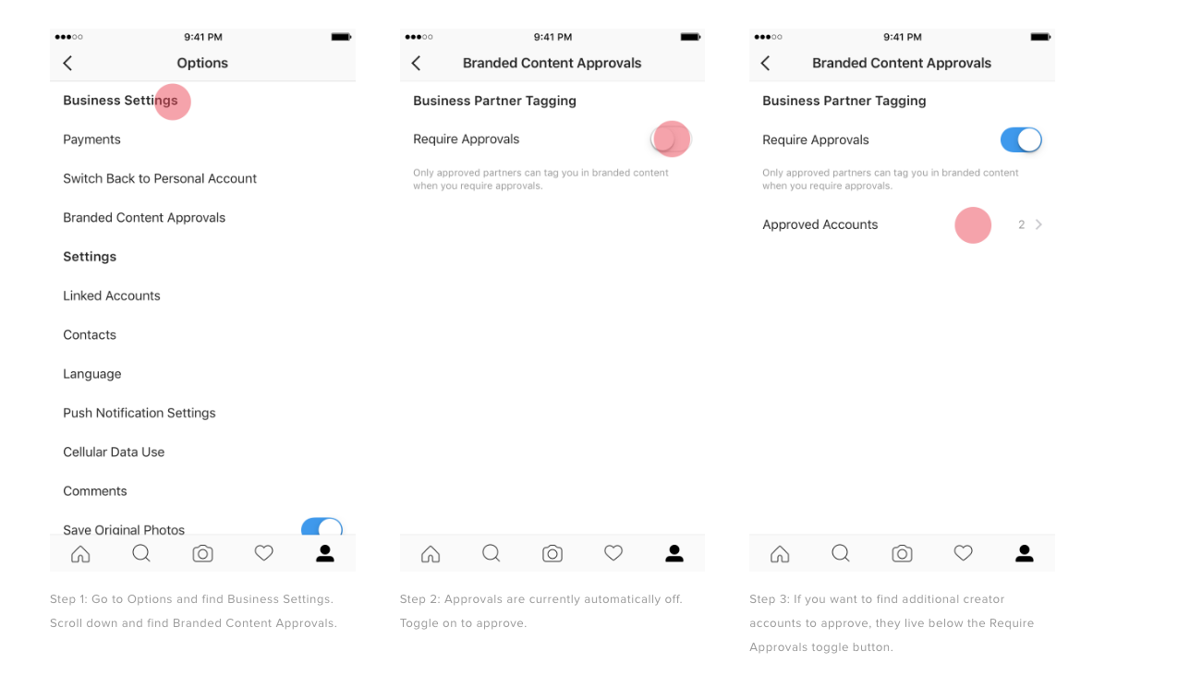
Let’s Talk Legal- Instagram
business.instagram.com/a/brandedcontentexpansion

Slide 45
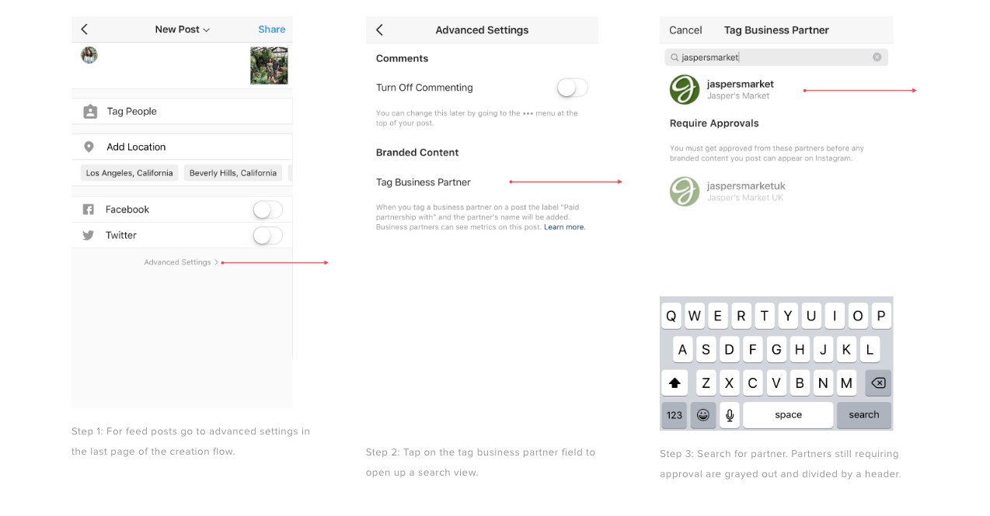
Let’s Talk Legal- Instagram
business.instagram.com/a/brandedcontentexpansion

Slide 46
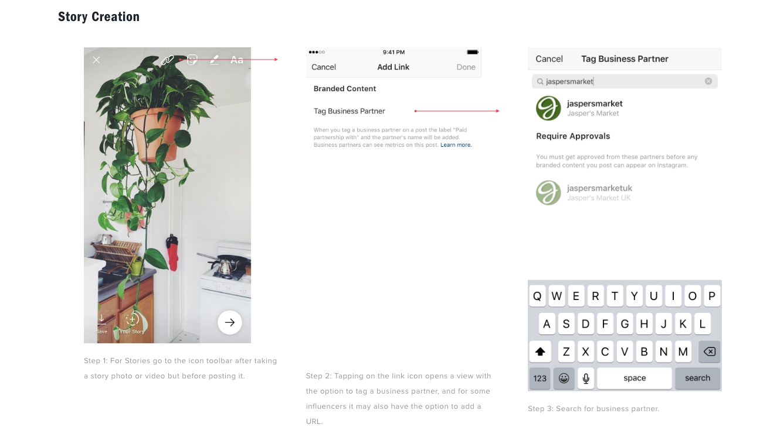
Let’s Talk Legal- Instagram
business.instagram.com/a/brandedcontentexpansion

Slide 47
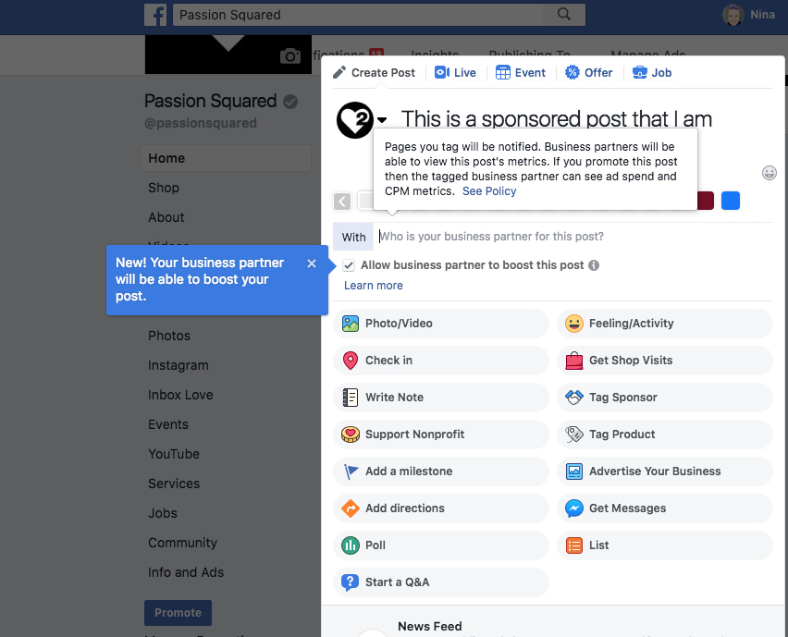
Let’s Talk Legal- Facebook
www.facebook.com/facebookmedia/get-started/branded-content

Slide 48
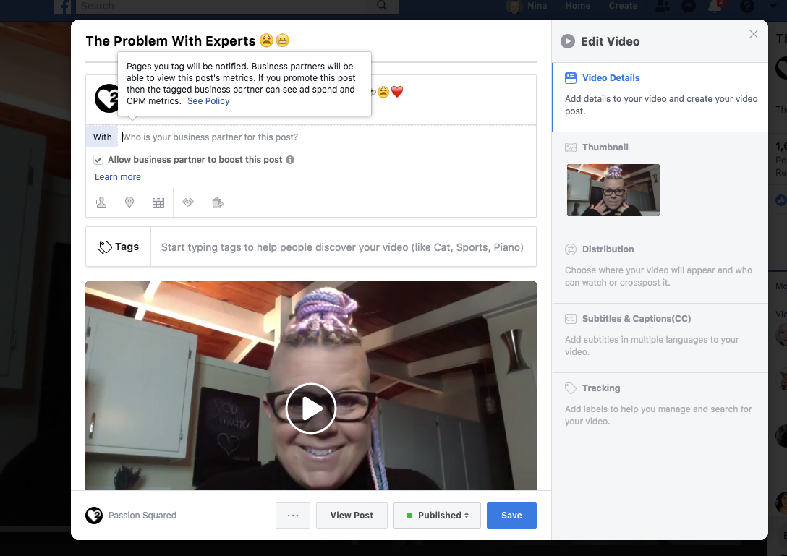
Let’s Talk Legal- Facebook
facebook.com/facebookmedia/get-started/branded-content

Slide 49
Let’s Talk About What Nobody Want’s To Talk About- Ethics
2017:
Nearly all studies and articles are showing that brands are moving towards micro influencers…
Why?
Bots, purchased followers, lower engagement and pods.
Followers do not necessarily equal infuence!
2018: Brands are super dialed in now to influencers who have little influence

Slide 50
Let’s Talk Opportunity
Social influence can lead to…
Education opportunties
Business opportunties
Brand parterships
Collabs
Your own brand

Slide 51
Influencer Services
Instagram bio
Brand listed @ in bio
Hashtag in bio
Link in bio
Instagram content
Post/Video
IGTV
LIVE
Stories (Image, video, Swipe Up, Polls)
Facebook
Post/Video
LIVE

Slide 52
Influencer Services
Blog/Vlog
Post
Newsletter
Sponsored
YouTube
Video
Events
Appearance
Posts promoting event

Slide 53
Influencer Services
Exclusive original content
This is content you create exclusively for a brand.
Organic Content
This is your regular content that you use brand product/hashtags, etc.

Slide 54
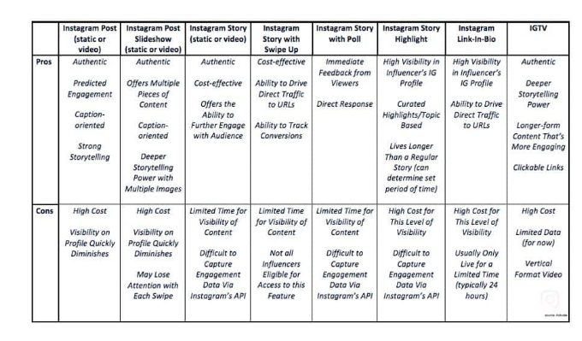
Let’s Talk Services

Slide 55
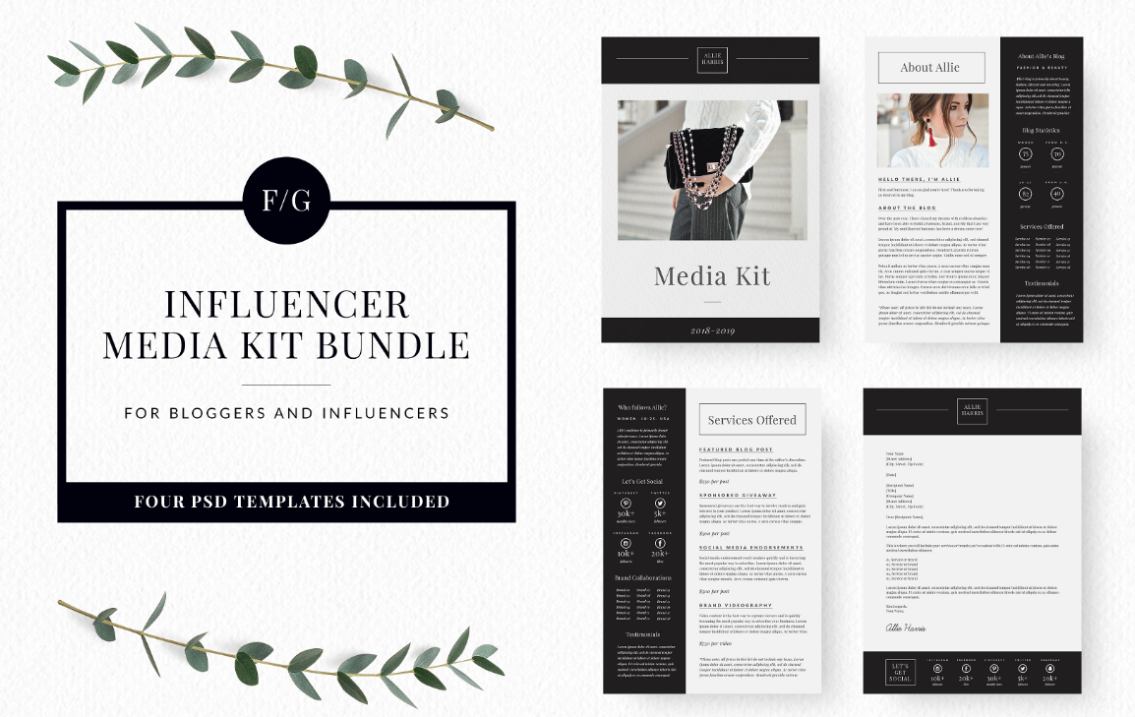
Marketing Yourself- Media Kit
creativemarket.com

Slide 56
Marketing Yourself- Media Kit
creativemarket.com

Slide 57
Your Media Kit
What you need for a media kit
About you (brand purpose, promise, people)
Contact info
Social page names
Images of you, your pages, your work, mentions, features
Social stats (Instagram, Facebook, blog traffic, email subscribers, etc.)
Content offerings/services
Price Menu

Slide 58
Influencer Contract
Most brands will have a contract, you can have one too.
What to look for in a contract;
Dates and deadlines
Payment specifics
Ownership, rights to use
Specific deliverables; 1 video, 2 Polls, 1 link in bio, etc)
Exclusivity
Standard Legal Stuff

Slide 59
How Do You Become A Person of Influence?
Remember, your content is your marketing
What is your brand + story + specialty?
Who are your people?
Are you actively building relationships online?
Are you actively creating content and sharing it?
Is your engagement legit?
Begin here, actively engage with brands you love.

Slide 60
Next Steps
Think about if you want to move towards the influencer world
Ask yourself WHY and what outcome you are seeking
Which brands do you want to align yourself with and why?
Get clear on your personal brand, story, specialty
Create a content plan and start creating!
Begin to craft your media kit to get clear on your offers and rates
Engage, Engage, Engage!

Slide 61
Influencer Marketing 2.0
© Passion Squared 2018

